Slide 1

Chapter 9
Polymorphism

Slide 2
Chapter Scope
The role of polymorphism
Dynamic binding
Using inheritance for polymorphism
Exploring Java interfaces in more detail
Using interfaces for polymorphism
Polymorphic design

Slide 3
Binding
Consider the following method invocation:
obj.doIt();
At some point, this invocation is bound to the definition of the method that it invokes
If this binding occurred at compile time, then that line of code would call the same method every time
But Java defers method binding until run time; this is called dynamic binding or late binding

Slide 4
Polymorphism
The term polymorphism literally means “having many forms”
A polymorphic reference is a variable that can refer to different types of objects at different points in time
The method invoked through a polymorphic reference can change from one invocation to the next
All object references in Java are potentially polymorphic

Slide 5
Polymorphism
Suppose we create the following reference variable
Occupation job;
Java allows this reference to point to an Occupation object, or to any object of any compatible type
This compatibility can be established using inheritance or using interfaces
Careful use of polymorphic references can lead to elegant, robust software designs

Slide 6
References and Inheritance
An object reference can refer to an object of its class, or to an object of any class related to it by inheritance
For example, if the Holiday class is the parent of Christmas, then a Holiday reference could be used to point to a Christmas object
Holiday special = new Christmas();

Slide 7
References and Inheritance
Assigning a child object to a parent reference is considered to be a widening conversion, and can be performed by simple assignment
Assigning an parent object to a child reference can be done also, but it is considered a narrowing conversion and must be done with a cast
The widening conversion is the most useful

Slide 8
Polymorphism via Inheritance
It is the type of the object being referenced, not the reference type, that determines which method is invoked
Suppose the Mammal class has a method called move, and the Horse class overrides it
Now consider the following invocation
pet.move();
If pet refers to a Mammal object, it invokes the Mammal version of move; if it refers to a Horse object, it invokes the Horse version

Slide 9
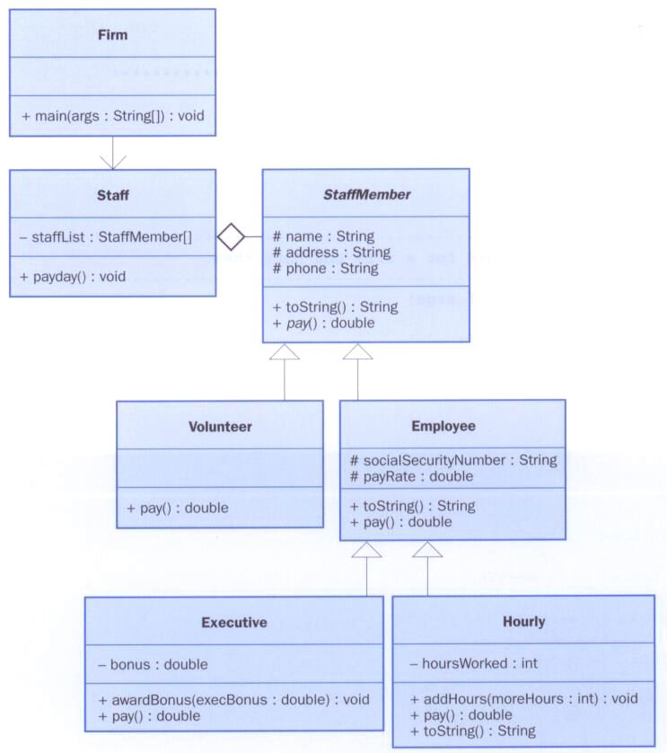
Let’s look at an example that pays a set of employees using a polymorphic method

Slide 10
//********************************************************************
// Firm.java Java Foundations
//
// Demonstrates polymorphism via inheritance.
//********************************************************************
public class Firm
{
//-----------------------------------------------------------------
// Creates a staff of employees for a firm and pays them.
//-----------------------------------------------------------------
public static void main(String[] args)
{
Staff personnel = new Staff();
personnel.payday();
}
}

Slide 11
//********************************************************************
// Staff.java Java Foundations
//
// Represents the personnel staff of a particular business.
//********************************************************************
public class Staff
{
private StaffMember[] staffList;
//-----------------------------------------------------------------
// Constructor: Sets up the list of staff members.
//-----------------------------------------------------------------
public Staff()
{
staffList = new StaffMember[6];
staffList[0] = new Executive("Tony", "123 Main Line",
"555-0469", "123-45-6789", 2423.07);
staffList[1] = new Employee("Paulie", "456 Off Line",
"555-0101", "987-65-4321", 1246.15);
staffList[2] = new Employee("Vito", "789 Off Rocker",
"555-0000", "010-20-3040", 1169.23);
staffList[3] = new Hourly("Michael", "678 Fifth Ave.",
"555-0690", "958-47-3625", 10.55);

Slide 12
staffList[4] = new Volunteer("Adrianna", "987 Babe Blvd.",
"555-8374");
staffList[5] = new Volunteer("Benny", "321 Dud Lane",
"555-7282");
((Executive)staffList[0]).awardBonus(500.00);
((Hourly)staffList[3]).addHours(40);
}
//-----------------------------------------------------------------
// Pays all staff members.
//-----------------------------------------------------------------
public void payday()
{
double amount;
for (int count=0; count < staffList.length; count++)
{
System.out.println (staffList[count]);
amount = staffList[count].pay(); // polymorphic
if (amount == 0.0)
System.out.println("Thanks!");
else
System.out.println("Paid: " + amount);
System.out.println("-----------------------------------");
}
}
}

Slide 13
//********************************************************************
// StaffMember.java Java Foundations
//
// Represents a generic staff member.
//********************************************************************
abstract public class StaffMember
{
protected String name;
protected String address;
protected String phone;
//-----------------------------------------------------------------
// Constructor: Sets up this staff member using the specified
// information.
//-----------------------------------------------------------------
public StaffMember(String eName, String eAddress, String ePhone)
{
name = eName;
address = eAddress;
phone = ePhone;
}

Slide 14
//-----------------------------------------------------------------
// Returns a string including the basic employee information.
//-----------------------------------------------------------------
public String toString()
{
String result = "Name: " + name + "\n";
result += "Address: " + address + "\n";
result += "Phone: " + phone;
return result;
}
//-----------------------------------------------------------------
// Derived classes must define the pay method for each type of
// employee.
//-----------------------------------------------------------------
public abstract double pay();
}

Slide 15
//********************************************************************
// Volunteer.java Java Foundations
//
// Represents a staff member that works as a volunteer.
//********************************************************************
public class Volunteer extends StaffMember
{
//-----------------------------------------------------------------
// Constructor: Sets up this volunteer using the specified
// information.
//-----------------------------------------------------------------
public Volunteer(String eName, String eAddress, String ePhone)
{
super(eName, eAddress, ePhone);
}
//-----------------------------------------------------------------
// Returns a zero pay value for this volunteer.
//-----------------------------------------------------------------
public double pay()
{
return 0.0;
}
}

Slide 16
//********************************************************************
// Employee.java Java Foundations
//
// Represents a general paid employee.
//********************************************************************
public class Employee extends StaffMember
{
protected String socialSecurityNumber;
protected double payRate;
//-----------------------------------------------------------------
// Constructor: Sets up this employee with the specified
// information.
//-----------------------------------------------------------------
public Employee(String eName, String eAddress, String ePhone,
String socSecNumber, double rate)
{
super(eName, eAddress, ePhone);
socialSecurityNumber = socSecNumber;
payRate = rate;
}

Slide 17
//-----------------------------------------------------------------
// Returns information about an employee as a string.
//-----------------------------------------------------------------
public String toString()
{
String result = super.toString();
result += "\nSocial Security Number: " + socialSecurityNumber;
return result;
}
//-----------------------------------------------------------------
// Returns the pay rate for this employee.
//-----------------------------------------------------------------
public double pay()
{
return payRate;
}
}

Slide 18
//********************************************************************
// Executive.java Java Foundations
//
// Represents an executive staff member, who can earn a bonus.
//********************************************************************
public class Executive extends Employee
{
private double bonus;
//-----------------------------------------------------------------
// Constructor: Sets up this executive with the specified
// information.
//-----------------------------------------------------------------
public Executive(String eName, String eAddress, String ePhone,
String socSecNumber, double rate)
{
super(eName, eAddress, ePhone, socSecNumber, rate);
bonus = 0; // bonus has yet to be awarded
}
//-----------------------------------------------------------------
// Awards the specified bonus to this executive.
//-----------------------------------------------------------------
public void awardBonus(double execBonus)
{
bonus = execBonus;
}

Slide 19
//-----------------------------------------------------------------
// Computes and returns the pay for an executive, which is the
// regular employee payment plus a one-time bonus.
//-----------------------------------------------------------------
public double pay()
{
double payment = super.pay() + bonus;
bonus = 0;
return payment;
}
}

Slide 20
//********************************************************************
// Hourly.java Java Foundations
//
// Represents an employee that gets paid by the hour.
//********************************************************************
public class Hourly extends Employee
{
private int hoursWorked;
//-----------------------------------------------------------------
// Constructor: Sets up this hourly employee using the specified
// information.
//-----------------------------------------------------------------
public Hourly(String eName, String eAddress, String ePhone,
String socSecNumber, double rate)
{
super(eName, eAddress, ePhone, socSecNumber, rate);
hoursWorked = 0;
}

Slide 21
//-----------------------------------------------------------------
// Adds the specified number of hours to this employee's
// accumulated hours.
//-----------------------------------------------------------------
public void addHours(int moreHours)
{
hoursWorked += moreHours;
}
//-----------------------------------------------------------------
// Computes and returns the pay for this hourly employee.
//-----------------------------------------------------------------
public double pay()
{
double payment = payRate * hoursWorked;
hoursWorked = 0;
return payment;
}

Slide 22
//-----------------------------------------------------------------
// Returns information about this hourly employee as a string.
//-----------------------------------------------------------------
public String toString()
{
String result = super.toString();
result += "\nCurrent hours: " + hoursWorked;
return result;
}
}

Slide 23
Interfaces
A Java interface is a collection of abstract methods and constants
An abstract method is a method header without a method body
An abstract method can be declared using the modifier abstract, but because all methods in an interface are abstract, usually it is left off
An interface is used to establish a set of methods that a class will implement

Slide 24
Interfaces
interface is a reserved word
None of the methods in
an interface are given
a definition (body)
public interface Doable
{
public void doThis();
public int doThat();
public void doThis2(float value, char ch);
public boolean doTheOther(int num);
}
A semicolon immediately
follows each method header

Slide 25
Interfaces
An interface cannot be instantiated
Methods in an interface have public visibility by default
A class formally implements an interface by
stating so in the class header
providing implementations for each abstract method in the interface
If a class states that it implements an interface, it must define all methods in the interface

Slide 26
Interfaces
public class CanDo implements Doable
{
public void doThis ()
{
// whatever
}
public void doThat ()
{
// whatever
}
// etc.
}
implements is a
reserved word
Each method listed
in Doable is
given a definition

Slide 27
Interfaces
A class that implements an interface can implement other methods as well
In addition to (or instead of) abstract methods, an interface can contain constants
When a class implements an interface, it gains access to all its constants

Slide 28
//********************************************************************
// Encryptable.java Java Foundations
//
// Represents the interface for an object that can be encrypted
// and decrypted.
//********************************************************************
public interface Encryptable
{
public void encrypt();
public String decrypt();
}

Slide 29
//********************************************************************
// Secret.java Java Foundations
//
// Represents a secret message that can be encrypted and decrypted.
//********************************************************************
import java.util.Random;
public class Secret implements Encryptable
{
private String message;
private boolean encrypted;
private int shift;
private Random generator;
//-----------------------------------------------------------------
// Constructor: Stores the original message and establishes
// a value for the encryption shift.
//-----------------------------------------------------------------
public Secret(String msg)
{
message = msg;
encrypted = false;
generator = new Random();
shift = generator.nextInt(10) + 5;
}

Slide 30
//-----------------------------------------------------------------
// Encrypts this secret using a Caesar cipher. Has no effect if
// this secret is already encrypted.
//-----------------------------------------------------------------
public void encrypt()
{
if (!encrypted)
{
String masked = "";
for (int index=0; index < message.length(); index++)
masked = masked + (char)(message.charAt(index)+shift);
message = masked;
encrypted = true;
}
}

Slide 31
//-----------------------------------------------------------------
// Decrypts and returns this secret. Has no effect if this
// secret is not currently encrypted.
//-----------------------------------------------------------------
public String decrypt()
{
if (encrypted)
{
String unmasked = "";
for (int index=0; index < message.length(); index++)
unmasked = unmasked + (char)(message.charAt(index)-shift);
message = unmasked;
encrypted = false;
}
return message;
}

Slide 32
//-----------------------------------------------------------------
// Returns true if this secret is currently encrypted.
//-----------------------------------------------------------------
public boolean isEncrypted()
{
return encrypted;
}
//-----------------------------------------------------------------
// Returns this secret (may be encrypted).
//-----------------------------------------------------------------
public String toString()
{
return message;
}
}

Slide 33
//********************************************************************
// SecretTest.java Java Foundations
//
// Demonstrates the use of a formal interface.
//********************************************************************
public class SecretTest
{
//-----------------------------------------------------------------
// Creates a Secret object and exercises its encryption.
//-----------------------------------------------------------------
public static void main(String[] args)
{
Secret hush = new Secret("Wil Wheaton is my hero!");
System.out.println(hush);
hush.encrypt();
System.out.println(hush);
hush.decrypt();
System.out.println(hush);
}
}

Slide 34
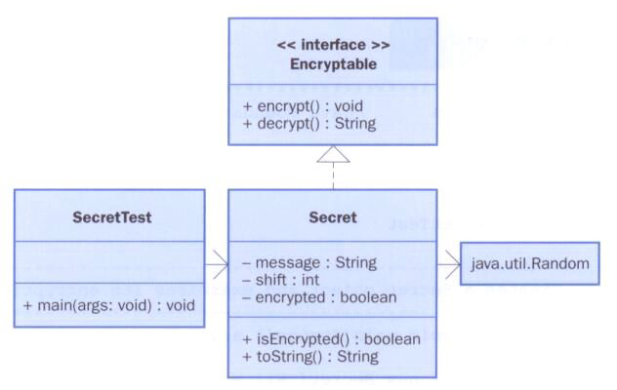
Interfaces
In UML, a dotted arrow is used to show that a class implements an interface
The designation <<interface>> is used to indicate an interface

Slide 35
Interfaces
A class can implement multiple interfaces
The interfaces are listed in the implements clause
The class must implement all methods in all interfaces listed in the header
class ManyThings implements Interface1, Interface2
{
// all methods of both interfaces
}

Slide 36
Interfaces
The Java API contains many helpful interfaces
The Comparable interface contains one abstract method called compareTo, which is used to compare two objects
We discussed the compareTo method of the String class in Chapter 4
The String class implements Comparable, giving us the ability to put strings in lexicographic order

Slide 37
The Comparable Interface
Any class can implement Comparable to provide a mechanism for comparing objects of that type
if (obj1.compareTo(obj2) < 0)
System.out.println("obj1 is less than obj2");
The value returned from compareTo should be negative is obj1 is less that obj2, 0 if they are equal, and positive if obj1 is greater than obj2
When you design a class that implements the Comparable interface, it should follow this intent

Slide 38
The Comparable Interface
It’s up to the programmer to determine what makes one object less than another
For example, you may define the compareTo method of an Employee class to order employees by name (alphabetically) or by employee number
The implementation of the method can be as straightforward or as complex as needed for the situation

Slide 39
The Iterator Interface
As we discussed in Chapter 4, an iterator is an object that provides a means of processing a collection of objects one at a time
An iterator is created formally by implementing the Iterator interface, which contains three methods
The hasNext method returns a boolean result – true if there are items left to process
The next method returns the next object in the iteration
The remove method removes the object most recently returned by the next method

Slide 40
The Iterator Interface
By implementing the Iterator interface, a class formally establishes that objects of that type are iterators
The programmer must decide how best to implement the iterator functions
Once established, the for-each version of the for loop can be used to process the items in the iterator

Slide 41
Interfaces
You could write a class that implements certain methods (such as compareTo) without formally implementing the interface (Comparable)
However, formally establishing the relationship between a class and an interface allows Java to deal with an object in certain ways
Which brings us back to polymorphism

Slide 42
References and Interfaces
Suppose we have an interface called Speaker:
public interface Speaker
{
public void speak();
public void announce(String str);
}
The interface name can now be used as the type of a reference variable:
Speaker current;
The variable current can now point to any object of any class that implements Speaker

Slide 43
Polymorphism via Interfaces
The version of speak that the following line invokes depends on the type of object that current is referencing:
current.speak();
This is analogous to the technique for polymorphism using inheritance

Slide 44
Polymorphism via Interfaces
Suppose two classes, Philosopher and Dog, both implement the Speaker interface, providing distinct versions of the speak method
In the following code, the first call to speak invokes one version and the second invokes another:
Speaker guest = new Philospher();
guest.speak();
guest = new Dog();
guest.speak();

Slide 45
Event Processing
Polymorphism plays an important role in the development of a Java graphical user interface
As we’ve seen, we establish a relationship between a component and a listener:
JButton button = new JButton();
button.addActionListener(new MyListener());
Note that the addActionListener method is accepting a MyListener object as a parameter
We can pass any object that implements the ActionListener interface to the addActionListener method

Slide 46
Event Processing
The source code for the addActionListener method accepts a parameter of type ActionListener (the interface)
Because of polymorphism, any object that implements that interface is compatible with the parameter reference variable
The component can call the actionPerformed method because of the relationship between the listener class and the interface
Extending an adapter class to create a listener represents the same situation; the adapter class implements the appropriate interface already

